Slide 1

Database and Backend Implementation
This presentation details the database and backend implementation for a mobile-based attendance management system, developed by the Department of Computer Engineering at the University of Buea. We will explore the theoretical foundations, design principles, and practical considerations that underpin this robust system.
Mobile Attendance Management System
Group 17 | CEF 440 | Dr. Nkemeni Valery – May 2025

Slide 2
PRESENTATION FLOW
Data Elements Analysis
Conceptual Design:
ER Diagram Analysis
Database Normalization
EER Model and Hybrid Architecture
Backend Implementation

Slide 3
Data Elements Analysis
Data elements are the fundamental building blocks of any database system, derived from functional requirements. Following Elmasri and Navathe's theory, data elements must be atomic, relevant, and directly support business logic.
User Management
Academic Domain-Specific
Biometric & Location
Identity Authentication: Username and hashed password for secure login.
Student Profile: Matriculation number as a unique business identifier.
Facial Recognition: Encrypted face encodings, image, verification status, and timestamp.
Role-Based Authorization: Role field (Student, Educator, Administrator) for access control.
Course Management: Course code, name, lecturer ID, and schedule.
Geofencing: Unique ID, name, center coordinates (latitude, longitude), and altitude for location verification.
Audit Trail: Registration date and status for account lifecycle management.
Session Management: Scheduled and actual start times for accurate attendance.

Slide 4
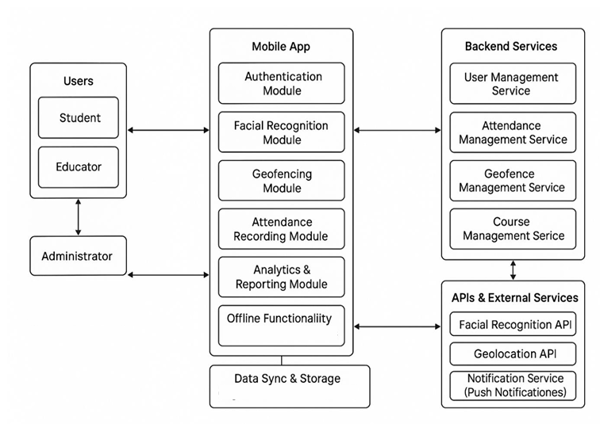




Conceptual Design: High-Level System Overview
The conceptual design provides a high-level view of data relationships without implementation details, crucial for stakeholder communication and system understanding. It outlines a layered data flow architecture.
Users
Students, Educators, and Administrators interact with the system for attendance, monitoring, and management.
Mobile App (Client-Side)
Core interface with modules for authentication, facial recognition, geofencing, attendance recording, analytics, and data synchronization.
Backend Services
Provides logic, processing, and data management for user, attendance, geofence, and course management.
APIs & External Services
Third-party tools like Facial Recognition API, Geolocation API, and Notification Service enhance system capabilities.

Slide 5
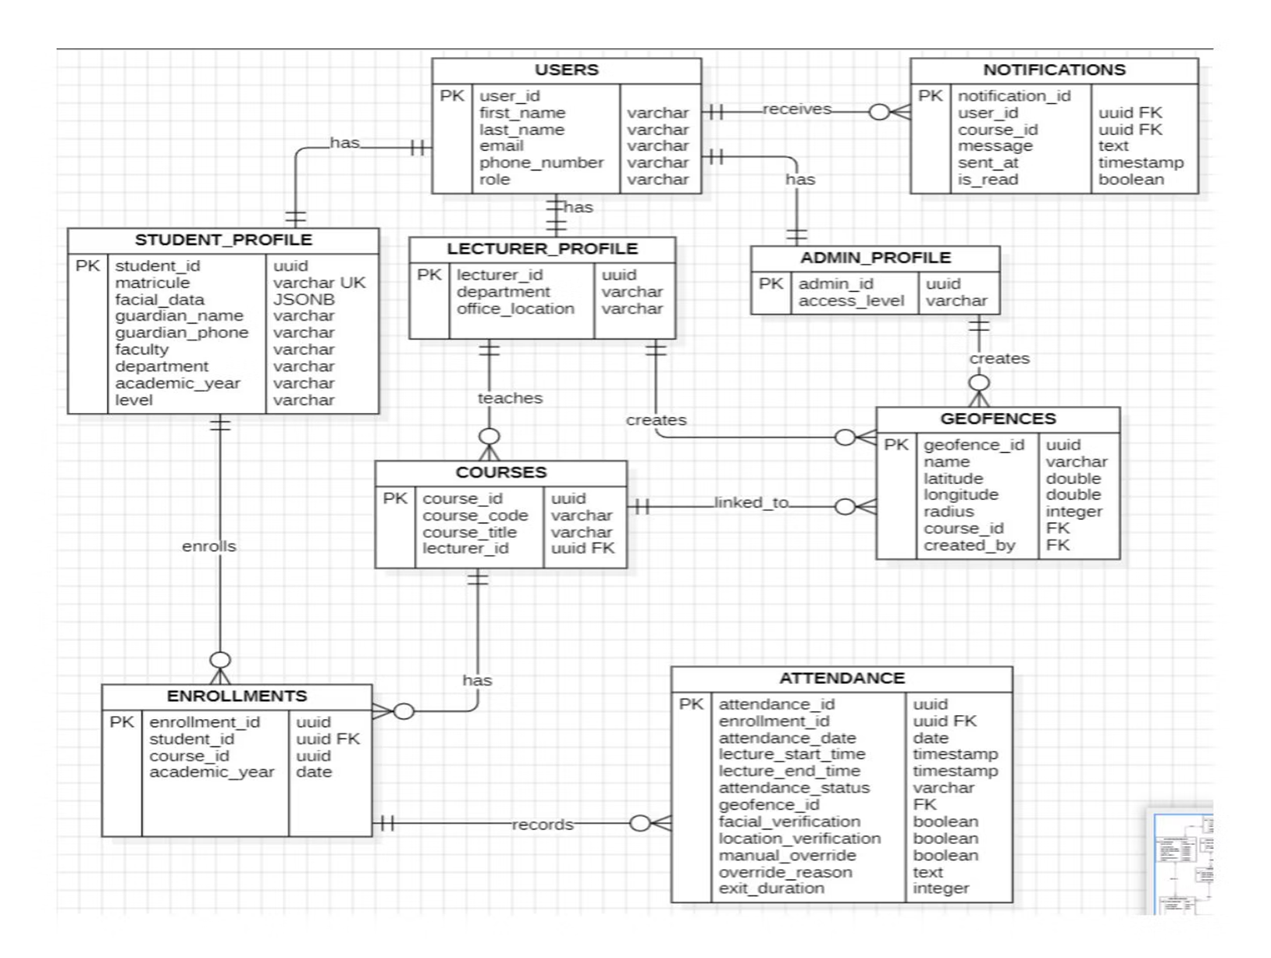
ER Diagram Analysis: Database Blueprint
The Entity-Relationship Diagram (ERD) serves as a blueprint for the database, illustrating entities, attributes, and relationships. This design is foundational for effective management of user information, course enrollment, attendance tracking, and communication.
Integrity Constraints
Relationship Cardinality
Referential Integrity: Foreign key relationships ensure data consistency.
One-to-Many: Users to Student Profiles, Courses to Class Sessions, Class Sessions to Attendance Records.
Domain Constraints: Enumerated types restrict field values.
Business Rule Constraints: Unique constraints prevent duplicate academic records.
Many-to-Many: Students to Courses (via Course Enrollments), Educators to Courses (via Course Assignments).
Entity Classification
Strong Entities: Users, Courses, Geofences (exist independently).
Weak Entities: Student Profiles, Educator Profiles (depend on Users).
Associative Entities: Course Enrollments, Attendance Records (represent many-to-many relationships).

Slide 6


Slide 7





Database Normalization: Ensuring Data Integrity
Database normalization systematically organizes data to eliminate redundancy and prevent anomalies, crucial for the attendance management system.
Eliminate Data Redundancy
Avoids storing the same data multiple times, reducing storage waste and maintenance challenges. For example, course information is stored once in a dedicated table.
Prevent Data Anomalies
Prevents update, insert, and delete anomalies that can lead to inconsistencies, incomplete data, or unintended data loss.
Ensure Data Integrity
Maintains referential integrity through foreign keys, enforces domain constraints, and automatically applies business rules.
Improve System Maintainability
Establishes a single source of truth, simplifies updates, and reduces human error by minimizing data duplication.

Slide 8
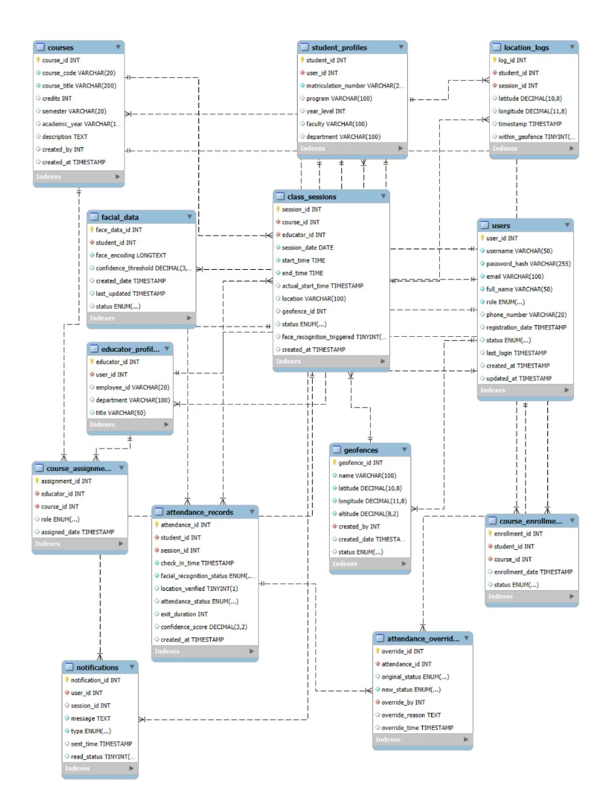
EER Model and Hybrid Architecture
The Enhanced Entity-Relationship (EER) model extends the basic ER diagram, providing superior semantic clarity and optimizing database design. This includes explicit representation of role-based access control, inheritance relationships, and precise constraint specification.
Hybrid Database Architecture
The implementation uses a polyglot persistence approach, combining SQL (MySQL) and NoSQL databases for optimal performance. SQL databases handle structured academic data requiring ACID properties (Atomicity, Consistency, Isolation, Durability).
Database Schema Design
Logical schema translates the ER model into database structures, defining tables, relationships, and constraints. Physical schema optimizes performance through indexing, partitioning, and storage optimization. Security includes field-level encryption for sensitive data like passwords and biometric information.
The EER model directly influences physical database implementation through table inheritance strategies, query optimization, and maintenance efficiency.

Slide 10




Backend Implementation: API Design and Data Processing
The backend leverages FastAPI principles for a modern, high-performance web framework. It focuses on resource-based URLs, HTTP method semantics, stateless communication, and standard status codes for consistent operation results.
API Design Architecture
Utilizes RESTful principles with clear resource endpoints and HTTP methods. Designed for potential microservices migration for authentication, attendance, course management, and notifications.
Data Processing Algorithms
Includes facial recognition (face detection, feature extraction, matching, confidence scoring) and geofencing calculations (coordinate system, distance calculation, boundary detection, accuracy considerations).
Real-Time Processing
Critical operations like authentication, attendance submission, and location verification are synchronous. Non-critical tasks like complex facial recognition, bulk notifications, and analytics generation are asynchronous.

Slide 11
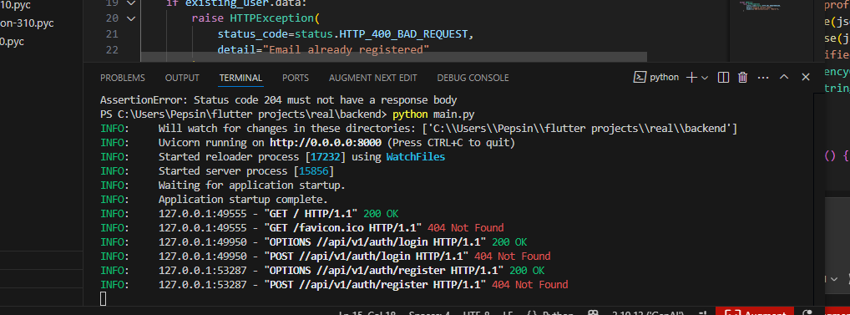
Backend Implementation: Endpoints

Slide 12

Database-Backend Integration and Conclusion
Effective integration is crucial for system performance and reliability. Connection pooling optimizes resource utilization, while transaction management ensures data consistency and handles errors gracefully.
1
Connection Management
Connection pooling for resource optimization, transaction management for data consistency, and deadlock prevention.
2
Data Synchronization
Online-first approach for real-time validation and immediate feedback, with offline capabilities including local storage and conflict resolution.
3
Performance Optimization
Query optimization through indexing and batch operations, scalability considerations via horizontal/vertical scaling, read replicas, and data archiving.
This comprehensive database and backend implementation provides a robust, secure, and scalable solution for mobile-based attendance management, leveraging established principles and modern technologies to meet the unique requirements of educational institutions.

Slide 13

Conclusion
The report concludes that the mobile-based attendance management system's design and implementation effectively addresses its requirements, utilizing a hybrid database approach for optimal performance and a modular design for future scalability. The system is robust and secure, integrating biometric authentication and location verification, making it suitable for modern educational institutions

